Slide 1
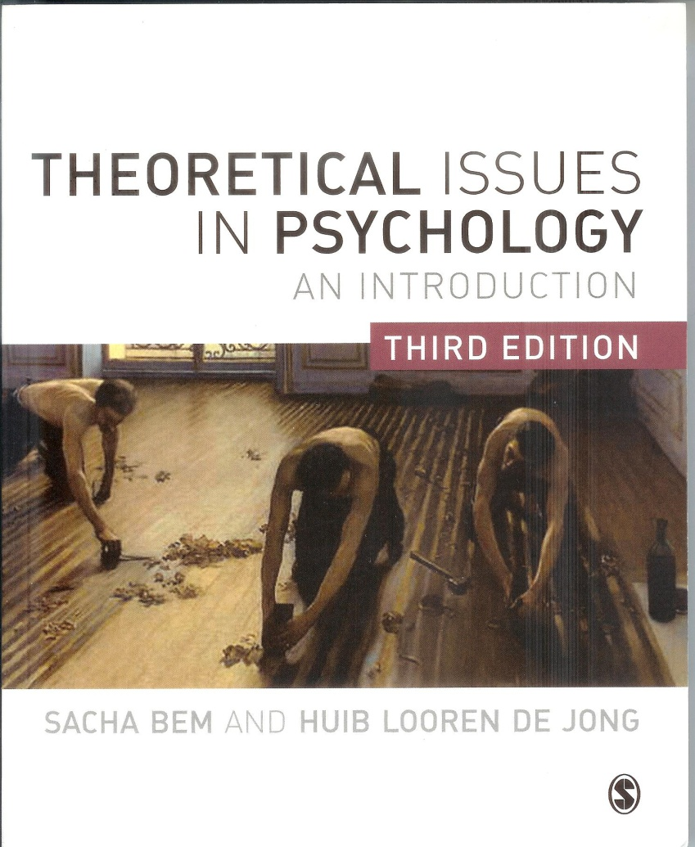
Theoretical Issues in Psychology
Philosophy of Science
and
Philosophy of Mind
for
Psychologists

Slide 2
Chapter 3
Philosophy of science (1)
Positivism and demarcation
Wittgenstein and language games
Problems for empirism:
Sellars and the Myth of the Given
Quine and epistemological holism
Hanson and theory-ladenness
Popper and falsification
Kuhn and paradigms
Lakatos and research programmes
Feyerabend and methodological anarchism

Slide 3
Positivism
and its decline
post-positivism
logical or neo positivism
positivism
1850
1920s
1960s
A. Comte
E. Mach
Quine
Wiener Kreis
Kuhn, Feyerabend

Slide 4
The Vienna Circle (Wiener Kreis) 1920s
Moritz Schlick
Rudolf Carnap
Otto Neurath

Slide 5
Logical positivism: the ‘standard’ (or ‘received’) view of science
Two sources for real knowledge: empirical data and logical reasoning.
Science is cumulative, progressive.
Scientism: only science provides true knowledge.
Science should be free from values (objectivism).
Tasks of philosophy of science is normative.
justification
norms
demarcation
The ‘received view’ of science.

Slide 6
The ingredients for science
according to positivism
Empirism and realism (or: instrumentalism).
Explanation: deducing facts from laws (DN-model).
Observation statements: foundations.
Verification and operationalisation.
Logical inferences and connections
→ unobservables connected to observations.
Justification: stress on method and norms
→ All this makes possible: certainty; and demarcation of science from religion, metaphysics, ideology and nonsense.

Slide 7
Logical positivism: empiricism plus logic
Elementary facts → observation statements plus
logical connections between them.
A neutral observation statement pictures an elementary fact (‘Protokollsätze’ e.g. meter readings).
Theory and unobservables only by virtue of connections with observations (theories should be determined by data)
→ against: unobservables, speculations, metaphysics, a priori theory.

Slide 8
The scientific process according to positivists
Observation: data gathering (fact finding).
Generalization: formulating laws (induction).
Verification: finding / searching for new facts.
Explanation: subsuming new facts (deduction).

Slide 9
Positivism in psychology: behaviorism
Elementary observations: stimuli & responses
Laws predict behavior.
Operationalization: e.g. learning is observable (and quantifiable) behavior (Thorndike).
Unobservables (e.g. ‘drive’) as hypothetical constructs in ‘black box’.
Carnap: Psychologie in physikalischer Sprache (Psychology in physical language) (1932)

Slide 10
Critics of positivism
1960s and 70s
Quine
Sellars
Wittgenstein
Hanson
Kuhn
Popper
Lakatos
Feyerabend

Slide 11
Post-positivist critics
The essence of early criticism
of positivism
is mainly epistemological, because
it emphasizes that ...
scientific objectivity cannot exist by
virtue of neutral observation of alleged
pure data out of the outside world;
objective observations
in this sense are not possible at all.

Slide 12
Sellars exposes the ‘Myth of the Given’
The myth implies:
that we receive pure sense data;
that each individual has direct knowledge of, and has a priviledged access to these mental states;
that this introspective knowledge is indisputable
(this is called ‘1st person’ knowledge).
Sellars: this knowledge is a myth; there are no pure observations.

Slide 13
Quine: epistemic holism
A single observation statement does not reflect a single state of affairs; it is not verifiable in isolation.
Observation statements are part of whole networks of beliefs, of whole theories: hence, they are only meaningful in the context of a theory.
There is no sharp distinction between empirical and theoretical statements.

Slide 14
Wittgenstein ‘I’ ( Tractatus,1921)
picture theory: language
refers to reality by means
of isomorphic logical structure,
meaning is reference.
Wittgenstein ‘II’ (Phil. Investigations, 1953):
language utterance is part of a whole
system of language: language game
(‘an activity, or form of life’);
‘meaning is use’:
importance of social context.
Relativism
truth depends
on user
Pragmatism
truth is what works

Slide 15
Hanson (Patterns of Discovery, 1958):
‘theory ladenness’ of observations:
‘to see is: to see as’
What do you see?

Slide 16
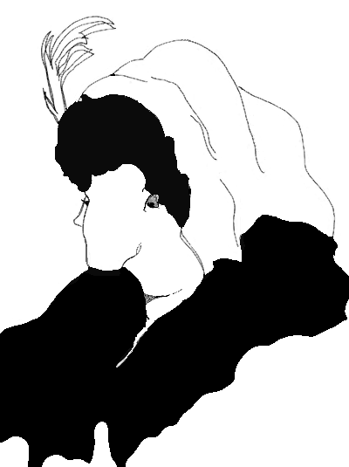
Hanson (Patterns of Discovery, 1958): ‘theory ladenness’ of observations: ‘to see is: to see as’
No separation of observation and theory: ‘seeing as’, intrepreted through theory.
Two astronomers watching the same sunrise see different things:
Tycho Brahe (geocentric view): sun rises.
Kepler (heliocentric): earth rises.
Gestalt-Switch

Slide 17
The criticism once more:
Sellars: that the so-called ‘Given’ (the ‘data’)
is indisputable is a myth.
Quine: observation statements are part of
whole theories.
Wittgenstein II: the meaning of a word is dependent on
the language game of which it is a part;
therefore its meaning is shown by how it is used.
Hanson: observation is theory laden;
to see is to see as.

Slide 18
Karl Popper (1902–1994)
Opposed to logical positivism.
Opposed to Kuhn.

Slide 19
Popper vs logical positivism
Logical-positivism:
induction;
generalisation;
verification.
A generalisation cannot
be verified: not all cases
can be examined
(induction problem).
Popper’s
conclusion:
the criterion of
science is:
FALSIFIABILITY
A generalisation can be
falsified: one counter-
example is enough.
Science is taking risks:
confirmation uninteresting,
no dogmatism.

Slide 20
Some logic:
two modes of inferences
modus ponens:
p > q
p
∴ q
p > q
q
∴ p
Popper’s
logic of
falsification:
modus tollens:
p > q
~ q
∴ ~ p
T> P
~ P
∴ ~ T
or

Slide 21
The positivist Hans Reichenbach (1930)
‘The principle of induction is of supreme importance for scientific method; it determines the truth of scientific theories. To eliminate it from science would mean nothing less than to deprive science of the power to decide the truth or falsity of its theories. Science would no longer have the right to distinguish its theories from the fanciful and arbitrary creations of the poet’s mind.’

Slide 22
Popper on the problem of induction (1959)
‘Many people believe that the truth of universal statements is “known by experience”; yet it is clear that an account of an experience, e.g., an observation, can in the first place be only a singular statement and not a universal one. And it is far from obvious, from a logical point of view, that we are justified in inferring universal statements from singular ones no matter how numerous. For any conclusion drawn in this way may always turn out to be false.’

Slide 23
Popper: on falsifiability, testability
‘What characterises the empirical method is its manner of exposing to falsification, in every conceivable way, the system to be tested. Its aim
is not to save the lives of untenable systems but, on the contrary, to select the one which is by comparison the fittest, by exposing them all to the fiercest struggle for survival’

Slide 24
Kuhn: The Structure of Scientific Revolutions (1962) don’t prescribe, but describe scientific development
paradigm
Normal science: working in the traditional way, under the umbrella of the actual paradigm.
Paradigm is theory as well as methods & techniques as well as social organisation.
Anomalies – crisis – scientific revolution – paradigm-shift (Gestalt switch).
Paradigms are incommensurable.

Slide 25
Gestalt switch

Slide 26
Kuhn: incommensurability
An evaluative order of paradigms is not possible
because there are no ahistorical criteria.
No rational justification outside paradigm.
No ‘foundationalism’.
No cumulation of truth.
No progress in science.
Relativism not realism.

Slide 27
Kuhn: paradigms and revolutions
Pre-paradigm (just collection of data, no framework):
➔ Paradigm (normal science between revolutions: puzzle solving):
➔ Crisis (anomalies): ➔ Revolution (paradigm loses grip, promise of new methods, criteria, institutions):
➔ New paradigm (normal science):
➔ Next crisis.
Within paradigm: puzzle solving, filling in the details, dogmatism, indispensable for progress.
Between paradigms revolution, indispensable for renewal (cf Popper).

Slide 28
Kuhn’s philosophy of science
Not normative: no prescription;
but descriptive: describing what scientists really do
therefore:
context of discovery
context of justification

Slide 29
Once more
Popper’s position:
no dogmatism
or conservatism
against
Kuhn’s
relativism:
falsification,
rational rejection
possible
against
positivism:
not verification,
but falsification

Slide 30
Imre Lakatos (1922–1974)
Combines elements of Kuhn’s paradigm
(dogmatism/conservatism)
and Popper’s falsificationalism (competion/progress):
rational reconstruction of scientific progress is possible
and relativism can be avoided
research programme:
hard-core of
theoretical
statements
protective
belt of auxilliary
hypotheses

Slide 31
Imre Lakatos (1922–1974)
Dogmatism/conservatism within research programs
and progress and rational choice between programs: relativism can be avoided:
Degenerating research program: just more and more ad-hoc hypotheses;
Progressive research programs: ad-hoc hypotheses lead to new predictions, data, applications;
Competition: rational choice, not just mob psychology (contra Kuhn);
Post-hoc, no a priori demarcation (contra falsificationism).

Slide 32
Paul Feyerabend (1924–1994)
No context-free rationality and foundations.
Against method (1975): methodological anarchism: methodological law-and-order hampers science.
Therefore: ‘Anything goes’; no demarcation.
Radicalises Kuhn’s relativism.
Science blooms by wild ideas and is not different from ideology and myth.
Science in a Free Society (1978).

Slide 33
Feyerabend: historicity of rationality
‘Arguments from methodology do not establish the excellence of science.
There is no “scientific method”. Every project, every theory, every procedure has to be judged on its own merits and by standards adapted to the processes with which it deals. The idea of a universal and stable method that is an unchanging measure of adequacy and even the idea of a universal and stable measuring instrument that measures any magnitude, no matter what the circumstances.
[T]here is not a single rule, however plausible and however firmly grounded in logic and general philosophy that is not violated at some time or other.’
(Science in a Free Society 1978: p. 98)

Slide 34
Feyerabend: relativism?
‘Philosophical relativism is the doctrine that all traditions, theories, ideas are equally true or equally false or, in an even more radical formulation, that any distribution of truth values over traditions is acceptable. This form of relativism is nowhere defended in the present book. It is not asserted, for example, that Aristotle is as good as Einstein; it is asserted and argued that “Aristotle is true” is a judgement that presupposes a certain tradition; it is a relational judgement that may change when the underlying tradition is changed.
There are standards, but they come from the research process
itself, not from abstract views of rationality.’
(Science in a Free Society 1978: p. 83 en 99)

Slide 35
Conclusion:
demarcation and rationality?
Logical positivism: yes, by verification.
Popper: yes, by falsification.
Kuhn: no, because relativism.
Lakatos: yes in retrospect (rational reconstruction).
Feyerabend: no, no context-free rationality.

