Slide 1
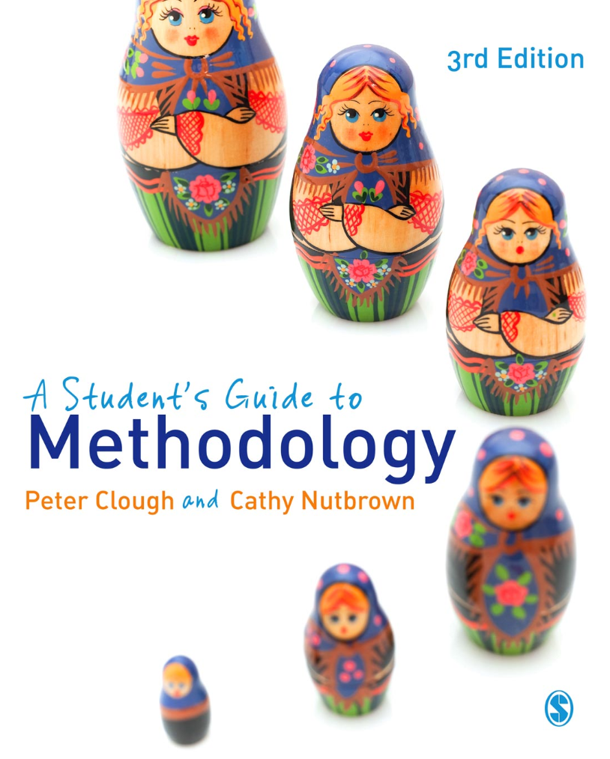
A Student’s Guide to Methodology
Justifying Enquiry
3rd edition
Peter Clough and
Cathy Nutbrown

Slide 2
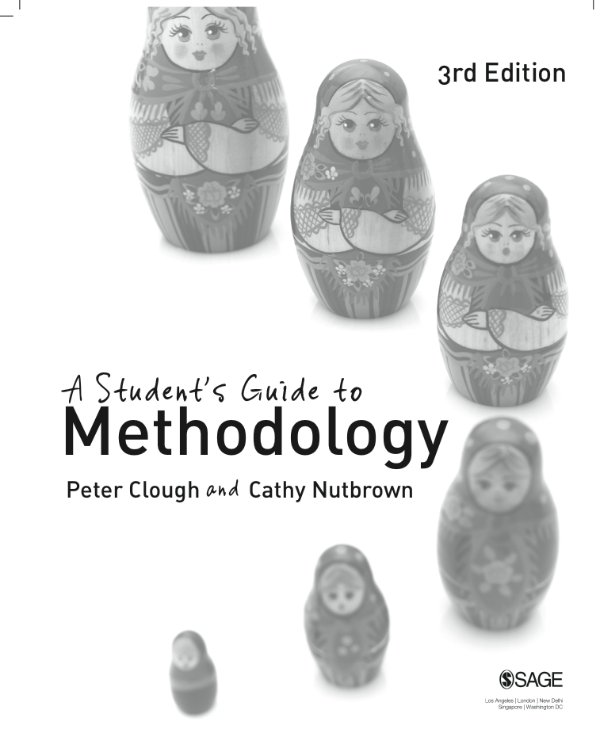
Chapter 8 Reporting research: telling the story
Making research ‘public’
We argue that social research is persuasive, purposive, positional and political. The arrest of experience, which is present in all research studies, can be characterised by four forms of radical enquiry, these being radical looking, radical listening, radical reading and radical questioning. These themes establish the essential methodological constructs of any successful piece of social research. The above themes pervade the writing of a research report and might be useful in deciding its specific genre and in planning its structure.

Slide 3
‘Systematic, self-critical enquiry – made public’
It was Stenhouse (1975) who wrote that: ‘Research ... is systematic and sustained enquiry, planned and self-critical, which is subjected to public criticism and to empirical tests where these are appropriate.’ In other words, research is not complete until it finds an audience.

Slide 4
Framework for analysis of research reports for their four key characteristics of social enquiry

Slide 5
Asking questions in relation to the 4 p’s
Is the report persuasive? In what ways?
Is the purpose of the research and its report clear?
How has the author demonstrated the positionality of the research?
In what way is the report political? What might be the political impact of the report?

Slide 6
Strategies for writing your research report
In the case of your own study, you need first to ask yourself, before you begin to write: What is the research story I wish to tell? Having decided this, the next question is: How can I best construct my research account?

Slide 7
Writing
We suggest that an important purpose of writing is thinking; of course people do indeed think as they write. But more than that, many use writing as the tool and process by which they decide what it is – precisely – that they are thinking.
Writing is not merely the means by which we record and report our thinking, but a means by which we discover it. It is for this reason that a ‘piece’ of writing may go through several drafts before it is offered into the public domain. Writing as process must not be confused with writing as product. The task of committing our ideas to paper forces a permanence of articulation which the spoken word can sometimes evade.

Slide 8
Writing for research
Writing is essential for ‘viewing’ our thinking, for discovering what it is we want to say. And reviewing our words and our thoughts once committed for the first time to paper is crucial in research writing.

Slide 9
A ‘rough guide’ to structure in dissertation and thesis writing
Title page (succinct and accurate)
Abstract (around 200 words providing a summary of the work)
Contents (lists of chapters, figures and tables)
Chapters
1 Introduction
2 Literature review
3 Research context, questions and rationale
4 Research methods and methodological issues
5 Research action – data collection and analysis
6 Research findings – and their relevance to the wider field of research
7 Reflection on the study – contributions, strengths and weaknesses
8 Conclusions – including future research questions
References (Find out the preferred style and ensure that you follow the appropriate conventions)
Appendices (Use appendices with reservation – if it is really important ask yourself whether the information you proposed to append should actually appear in the main body of the text. )

Slide 10
Critiquing your research writing
When you are drafting and redrafting your dissertation or thesis use this checklist of questions to critique your writing. Ask:
Is this report persuasive? How does it persuade? Who does it aim to persuade?
Is this report purposive? Does it make its purposes clear? How does it accomplish this?
Is this report an expression of the positional nature of the research? In what way?
Is this research political? How does the report connect with and articulate political issues?
Have I justified my enquiry through
radical looking?
radical listening?
radical reading?
radical questioning?
Do I need to locate this research within a particular research paradigm?

Slide 11
Ethics: pause for reflection
What are the ethical factors to be considered in preparing and publishing a research report?

