Slide 1
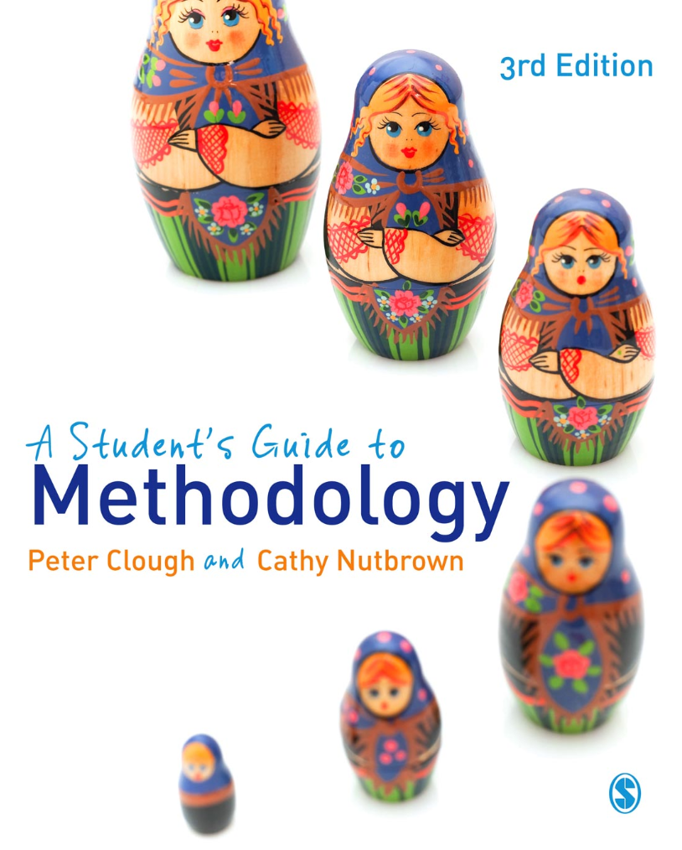
A Student’s Guide to Methodology
Justifying Enquiry
3rd edition
Peter Clough and
Cathy Nutbrown

Slide 2
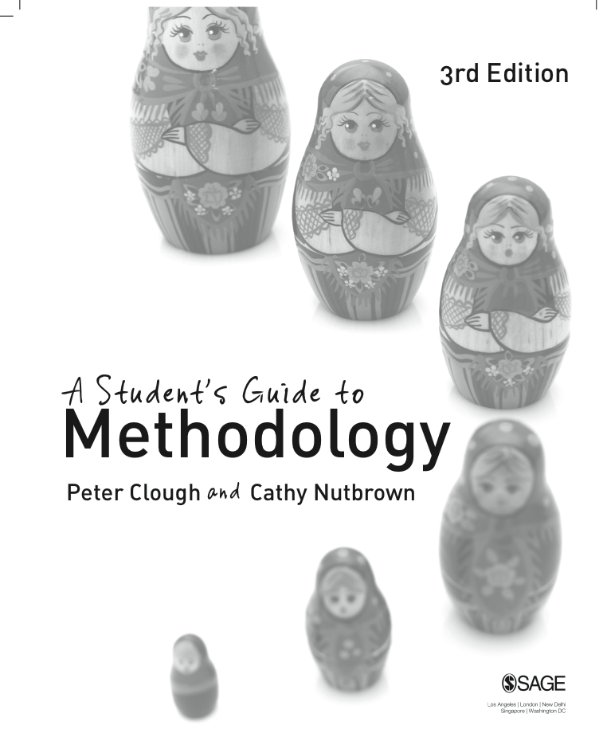
Chapter 7 Research design: shaping the study
The four ‘radical’ actions of social enquiry: radical looking, radical listening, radical reading and radical questioning can underpin and inform research design and planning, and be used to critique new research plans.

Slide 3
Developing questions
There are many ways in which research questions are constructed. With our focus now on research design we consider the vital relationship of the research question (or questions) to the research design. Research questions in the social sciences can be plotted along two axes: general–specific and breadth–depth.

Slide 4
Research questions can be placed along two axes: general-specific and breadth-depth

Slide 5
‘Being radical’ in research planning
Radical looking is the means by which the research process makes the familiar strange, and gaps in knowledge are revealed.
Radical listening – as opposed to merely hearing – is the interpretative and critical means through which ‘voice’ is noticed.
Radical reading provides the justification for the critical adoption or rejection of existing knowledge and practices.
Radical questioning reveals not only gaps in knowledge but why and how answers might be morally and politically necessitated in practices and lies at the heart of a thesis, bringing together the earlier notions of radically attending to a topic or situation of events.

Slide 6
We argue that social research is:
persuasive;
purposive;
positional;
and
political.
All social research sets out with specific purposes from a particular position, and aims to persuade readers of the significance of its claims; these claims are always broadly political.

Slide 7
Four ‘p’s of radical enquiry
Those who carry out social research aim to persuade readers of the significance of their claims.
What is often forgotten (as too obvious) is that any piece of research in the social sciences emerges from a distinct purpose (whether or not this is apparent to the reader).
Since research is carried out by people, it is inevitable that the standpoint of the researcher is a fundamental platform on which enquiry is developed; all social science research is saturated (however disguised) with positionality.
Research which changes nothing – not even the researcher – is not research at all. And since all social research takes place in policy contexts of one form or another research itself must therefore be seen as inevitably political.

Slide 8
‘prods’ for research design
Consider how our definition of social research as persuasive, purposive, positional and political together with our four processes of radical enquiry are integral to research design and planning and how, if these are held central in the researchers’ thinking, they will act as ‘prods’ for ongoing critique of any research plan as it is being developed.

Slide 9
Developing and critiquing research plans
The Research Planning Audit is a tool designed to help you devise your research plans and then subject them to some critical reflection. The Research Planning Audit* suggests that you focus on your reasons for choosing your research topic, first stating those reasons and then justifying them.
The Research Planning Audit* is on page 260 of the book and can be downloaded.

Slide 10
Ethical issues in research design and development
Ethical practices are central to social science research, and decisions about research questions, participants, publication, methods, analysis and so on are all taken with due regard to ethical judgements about what is ‘right’ and the importance of avoiding harm to participants or as a result of the study. Whilst procedures for the ethical review of students’ research will vary from institution to institution the ethical practices of all research will take similar issues into consideration and take account of legislative frameworks involving data protection, human rights, the Freedom of Information Act, and so on. Ethical issues are central to the methodology of any social science study however large or small .

Slide 11
Critical relationships in methodology
Research questions influence the design and planning of the study. The question of purpose is fundamental here.
If we examine the relationship between research questions and field questions we can see that they are connected and that this is a question of content.
Field questions must be phrased so as to respond eventually to the original research questions. Where field questions and research design and planning coincide it becomes a question of form.

Slide 12
‘Choosing’ methods?
Channels of communication determine what may pass along them. Research methods observe this rule.
Whether using large-scale questionnaire surveys, or smaller-scale and deeper interviews, in delimiting the sorts of information which may be accessed, channels of communication – in this case, particular research methods – represent (though often tacitly) differing views on how the world is constructed and how it operates.

Slide 13
The generation of field questions from research questions and their relation to research design and planning

Slide 14
Design and interpretation: drawing meaning from the questions
Analysis is the act of stripping away whatever clothes or disguises an object, so that we can see it in its simplest form.

Slide 15
Methods make objects
‘We do not come innocent to a task or a situation of events; rather we wilfully situate those events not merely in the institutional meanings which our profession provides but also, and in the same moment, we constitute them as expressions of our selves. Inevitably, the traces of our own psychic and social history drive us.’ (Clough, 1995: 138)

Slide 16
Ethics: pause for reflection
Does the scale of a study carry with it different ethical considerations?
What checks on the research design are needed at each stage of the study to ensure that ethical issues are fully identified and addressed?

