Slide 1
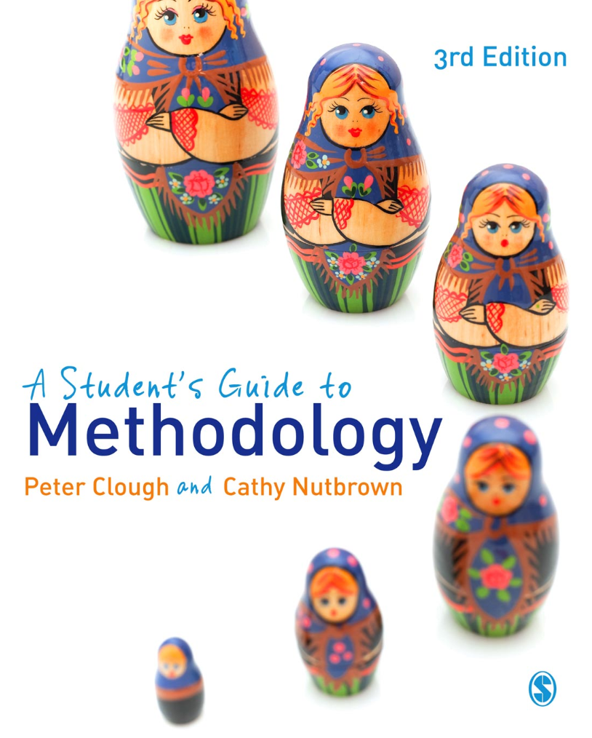
A Student’s Guide to Methodology
Justifying Enquiry
3rd edition
Peter Clough and
Cathy Nutbrown

Slide 2
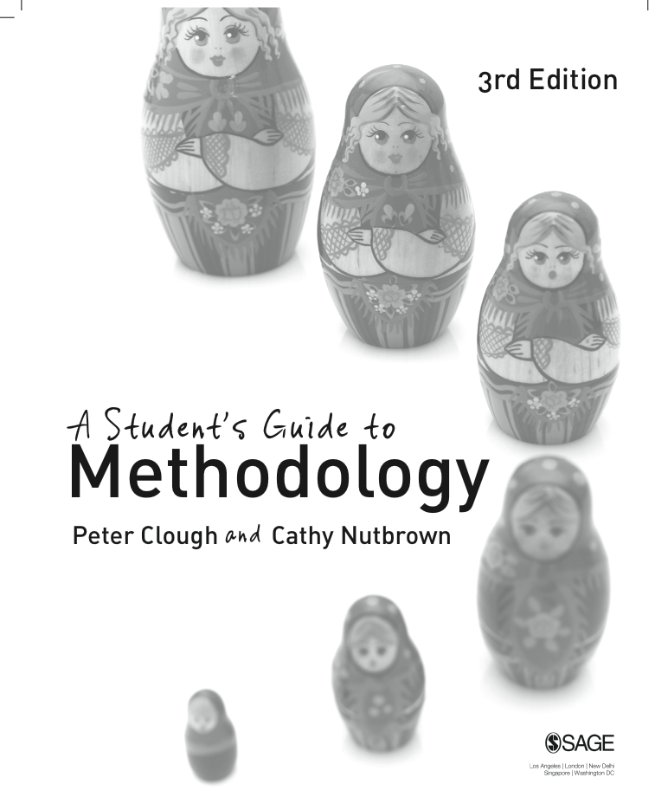
Chapter 6 Questioning: the focus of research
Radical questioning reveals not only gaps in knowledge but why and how answers might be morally and politically necessitated. Radical questioning lies at the heart of a research study, and brings together the earlier notions of radically attending to a topic or situation of events.

Slide 3
Asking questions
Research methodology involves at least four kinds of questions: self-questioning, research questions, field questions and ethical questions. These four kinds of questions serve different functions.
The most important are central questions of justification and our reason for investing in radical questioning of the moral and political roots of research studies.

Slide 4
How to ask – issues of method: using interviews and questionnaires
Popular methods for collecting data from research participants are interviews and questionnaires.
Are these the best method for your purposes? You need to think about the kind of data you want, and how much you want to control the interview. You need to decide whether you want to structure the interview so that you set the agenda, whether you simply want to listen to the interviewee’s ideas on a particular issue or topic, or whether you want a bit of both.

Slide 5
Interviewing: some hints
Do your interview questions help you to respond to your research questions?
Have you carried out a pilot run of your interview schedule?
Make sure the questions are clear
Generating data can be easy; be sure you can handle it all!
Get parents’ permission to interview children as well as permission from the young participants themselves
Give people time to respond – don’t rush
Make it easy for interviewees to respond
Listen
Make audio or visual recordings of your interviews
Test your equipment before each interview
Think about the arrangement of the room and seating for face-to-face interviews – make sure interviewees feel comfortable
Make ‘at a distance’/web-based interviews as comfortable as possible for the participants
Give your interviewees the opportunity to choose the time and location for interviews, but be aware that busy places can result in poor quality audio recordings and can be distracting for you and your interviewees – and difficult to transcribe
Tell participants why you are interviewing them
Explain what will happen to the recordings and transcripts – how they will be stored, used, made public and (ultimately) disposed of.

Slide 6
What do I do when I’ve done my interviews?
Once you have carried out your interviews you have a wealth of data which you must process and analyse. You need to ensure that you are remaining true to the voices of the research participants and developing responses to your research questions. You will need to become familiar with your interview recordings, transcripts and notes, get a ‘feel’ for the data and perhaps create an overview of what people have told you – your ‘impressions’ and ‘intuitions’.

Slide 7
Using questionnaires
Generally speaking, questionnaires allow researchers to survey a population of subjects, with little or no personal interaction, and with the aim of establishing a broad impression of their experiences or views. The important term here is broad, for it is unlikely that a questionnaire will reveal the depth of those views and experiences in any of their rich detail. This distinction is essentially what separates qualitative and quantitative approaches to enquiry.

Slide 8
Questionnaires: some hints
Do the field questions help you to respond to your research questions?
Have you carried out a pilot run of your questionnaire?
Are the questions clear? (you will not be there to clarify them)
Are you excluding any participants by requiring a particular level of literacy or using a particular language?
Questionnaires can quickly generate a large amount of data. Do you know how you will use it?
Make it easy to respond: include a stamped addressed envelope or administer electronically.
Think about offering anonymity.
How can/will you guarantee anonymity and/or confidentiality?
Set a timescale for returns.
What ethical issues do you need to address?

Slide 9
Future research questions
Much research generates further questions for future investigation. In this sense there will often be ‘more questions than answers’. It is often the case that research generates new questions and it is important to state these in a concluding section of your study. Such questions can be alerted in various ways – as a general statement about what is needed next in the field of enquiry or as specific questions or areas of concern which your own study did not address.

Slide 10
Ethics: pause for reflection
Radical questioning reveals not only gaps in knowledge but why and how answers might be morally and politically necessitated. What are the ethical implications of interviewing and other forms of questioning of research participants?
What are the ethical decisions which have to be taken when deciding on a sample of research participants?
What are the particular considerations around ethical practices in research using the internet?
How does the application of ethical research practices vary across cultures, generations and intellectual capacity? Does ‘one size fit all’?

